Slide 1




Computer Networks
OSI Transport Layer
Lecturer: Sura F. Ismail
Lecture Five
Second Class.
Time: 8: 30- 10:30
Department: Informatics Systems Management (ISM)

Slide 2
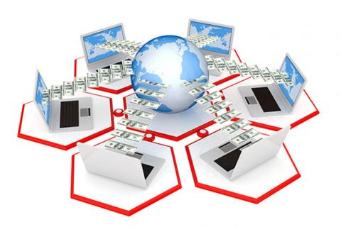
Outline
Outline
Overview
Roles of the Transport Layer

Slide 3
1. Overview
Outline
Data networks and the Internet support the human network by supplying seamless, reliable communication among people—both locally and around the globe. On a single device, people can use multiple services, such as e-mail, the web, and instant messaging, to send messages or retrieve information. Applications such as e-mail clients, web browsers, and instant messaging clients allow people to use computers and networks to send messages and find information.
Data from each of these applications is packaged, transported, and delivered to the appropriate server daemon or application on the destination device. The processes described in the OSI transport layer accept data from the application layer and prepare it for addressing at the network layer. The transport layer is responsible for the overall end-to-end transfer of application data.

Slide 4
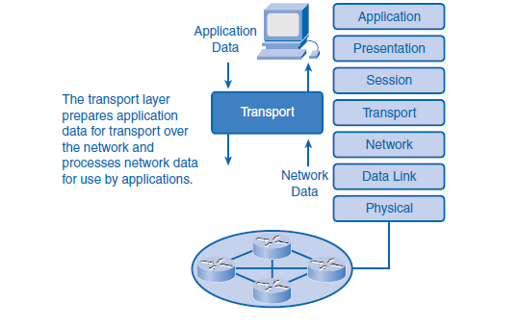
1. Overview
Outline

Slide 5
2. Roles of the Transport Layer
Outline
The transport layer provides transparent transfer of data between end users, providing reliable data transfer services to the upper layers.
The transport layer controls the reliability of a given link through flow control, segmentation/desegmentation, and error control. Some protocols are state and connection oriented. This means that the transport layer can keep track of the segments and retransmit those that fail.

Slide 6
2. Roles of the Transport Layer
Outline
Purpose of the Transport Layer
The following are the primary responsibilities of the transport layer:
Tracking the individual communications between applications on the source and destination hosts
Segmenting data and managing each piece
Reassembling the segments into streams of application data
Identifying the different applications
Performing flow control between end users
Enabling error recovery
Initiating a session

Slide 7
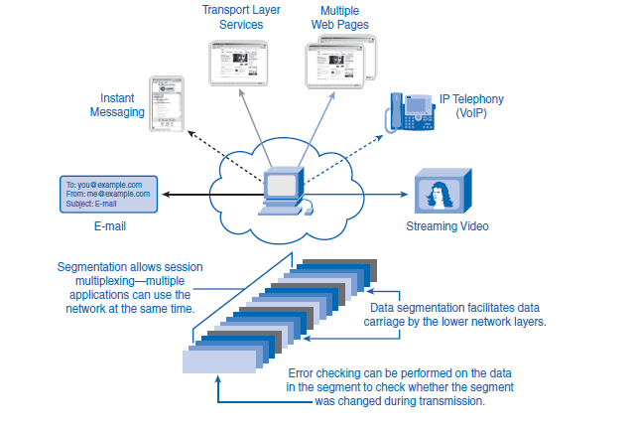
2. Roles of the Transport Layer
Outline

Slide 8
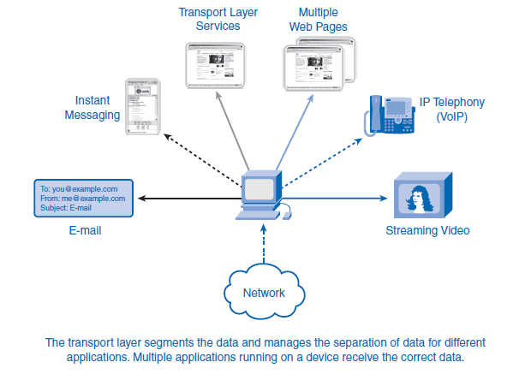
2. Roles of the Transport Layer
Outline
Tracking Individual Conversations
Any host can have multiple applications that are communicating across the network. Each of these applications will be communicating with one or more applications on remote hosts. It is the responsibility of the transport layer to maintain the multiple communication streams between these applications.

Slide 9
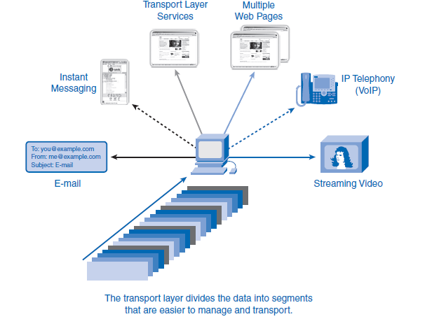
2. Roles of the Transport Layer
Outline
Segmenting Data
The application layer passes large amounts of data to the transport layer. The transport layer has to break the data into smaller pieces, better suited for transmission. These pieces are called segments. This process includes the encapsulation required on each piece of data. Each piece of application data requires headers to be added at the transport layer to indicate to which communication it is associated.

Slide 10
2. Roles of the Transport Layer
Outline
Reassembling Segments
Because networks can provide multiple routes that can have different transmission times, data can arrive in the wrong order. By numbering and sequencing the segments, the transport layer can ensure that these segments are reassembled into the proper order. At the receiving host, each segment of data must be reassembled in the correct order and then directed to the appropriate application. The protocols at the transport layer describe how the transport layer header information is used to reassemble the data pieces into in-order data streams to be passed to the application layer.

Slide 11
2. Roles of the Transport Layer
Outline
Identifying the Applications
To pass data streams to the proper applications, the transport layer must identify the target application. To accomplish this, the transport layer assigns an identifier to an application. The TCP/IP protocols call this identifier a port number. Each software process that needs to access the network is assigned a port number unique in that host. This port number is used in the transport layer header to indicate to which application that piece of data is associated. At the transport layer, each particular set of pieces flowing between a source application and a destination application is known as a conversation.
Dividing data into small parts, and sending these parts from the source to the destination, enables many different communications to be interleaved (multiplexed) on the same network. The transport layer is the link between the application layer and the lower layers that are responsible for network transmission. This layer accepts data from different conversations and passes it down to the lower layers as manageable pieces that can be eventually multiplexed over the media.

Slide 12
2. Roles of the Transport Layer
Outline
Flow Control
Network hosts have limited resources, such as memory or bandwidth. When the transport layer is aware that these resources are overtaxed, some protocols can request that the sending application reduce the rate of data flow. This is done at the transport layer by regulating the amount of data the source transmits as a group. Flow control can prevent the loss of segments on the network and avoid the need for retransmission.
Error Recovery
For many reasons, it is possible for a piece of data to become corrupted, or lost, as it is transmitted over the network. The transport layer can ensure that all pieces reach their destination by having the source device retransmit any data that is lost.
Initiating a Session
The transport layer can provide connection orientation by creating a session between the applications. These connections prepare the applications to communicate with each other before any data is transmitted. Within these sessions, the data for a communication between the two applications can be closely managed.

Slide 13
2. Roles of the Transport Layer
Outline
Data Requirements Vary
Multiple transport layer protocols exist to meet the requirements of different applications. For example, users require that an e-mail or web page be completely received and presented for the information to be considered useful. Slight delays are considered acceptable to ensure that the complete information is received and presented.
In contrast, occasionally missing small parts of a telephone conversation might be considered acceptable. You can either infer the missing audio from the context of the conversation or ask the other person to repeat what he said. This is considered preferable to the delays that would result from asking the network to manage and resend missing segments. In this example, the user, not the network, manages the resending or replacement of missing information. In today’s converged networks, where the flow of voice, video, and data travels over the same network, applications with very different transport needs can be communicating on the same network.

Slide 14
2. Roles of the Transport Layer
Outline
The different transport layer protocols have different rules allowing devices to handle these diverse data requirements. Some protocols, such as UDP (User Datagram Protocol), provide just the basic functions for efficiently delivering the data pieces between the appropriate applications. These types of protocols are useful for applications whose data is sensitive to delays. Other transport layer protocols, such as TCP (Transmission Control Protocol), describe processes that provide additional features, such as ensuring reliable delivery between the applications. While these additional functions provide more robust communication at the transport layer between applications, they have additional overhead and make larger demands on the network. To identify each segment of data, the transport layer adds to the piece a header containing binary data. This header contains fields of bits. The values in these fields enable different transport layer protocols to perform different functions.

Slide 15
2. Roles of the Transport Layer
Outline
Supporting Reliable Communication
Recall that the primary function of the transport layer is to manage the application data for the conversations between hosts. However, different applications have different requirements for their data, and therefore different transport protocols have been developed to meet these requirements.
TCP is a transport layer protocol that can be implemented to ensure reliable delivery of the data. In networking terms, reliability means ensuring that each piece of data that the source sends arrives at the destination. At the transport layer, the three basic operations of reliability are
Tracking transmitted data
Acknowledging received data
Retransmitting any unacknowledged data

Slide 16
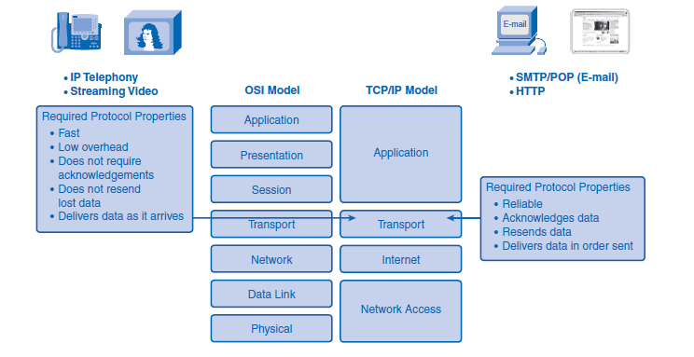
2. Roles of the Transport Layer
Outline
The transport layer of the sending host tracks all the data pieces for each conversation and retransmits any data that the receiving host did not acknowledge. These reliability processes place additional overhead on the network resources because of the acknowledgment, tracking, and retransmission. To support these reliability operations, more control data is exchanged between the sending and receiving hosts. This control information is contained in the Layer 4 header. This creates a trade-off between the value of reliability and the burden it places on the network. Application developers must choose which transport protocol type is appropriate based on the requirements of their applications.

Slide 17
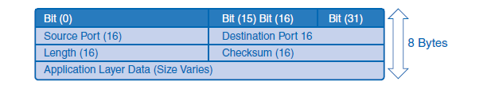
2. Roles of the Transport Layer
Outline
TCP and UDP
The two most common transport layer protocols of the TCP/IP protocol suite are Transmission Control Protocol (TCP) and User Datagram Protocol (UDP). Both protocols manage the communication of multiple applications. The differences between the two are the specific functions that each protocol implements.
User Datagram Protocol (UDP)
UDP is a simple, connectionless protocol, described in RFC 768. It has the advantage of providing low-overhead data delivery. The segments of communication in UDP are called datagrams. UDP sends datagrams as “best effort.” Applications that use UDP include
Domain Name System (DNS)
Video streaming
Voice over IP (VoIP)

Slide 18
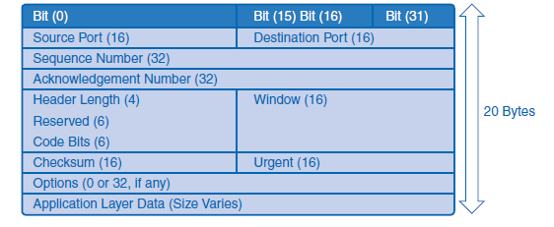
2. Roles of the Transport Layer
Outline
Transmission Control Protocol (TCP)
TCP is a connection-oriented protocol, described in RFC 793. TCP incurs additional overhead to gain functions. Additional functions specified by TCP are same-order delivery, reliable delivery, and flow control. Each TCP segment has 20 bytes of overhead in the header encapsulating the application layer data, whereas each UDP segment has only 8 bytes of overhead.
The following applications use TCP:
Web browsers
E-mail
File transfers

Slide 19
2. Roles of the Transport Layer
Outline
Port Addressing
Consider the earlier example of a computer simultaneously receiving and sending e-mail, instant messages, web pages, and a VoIP phone call. The TCP- and UDP-based services keep track of the various applications that are communicating. To differentiate the segments and datagrams for each application, both TCP and UDP have header fields that can uniquely identify these applications.
The header of each segment or datagram contains a source and destination port. The source port number is the number for this communication associated with the originating application on the local host. The destination port number is the number for this communication associated with the destination application on the remote host. Port numbers are assigned in various ways, depending on whether the message is a request or a response. While server processes have static port numbers assigned to them, clients dynamically choose a port number for each conversation.

Slide 20
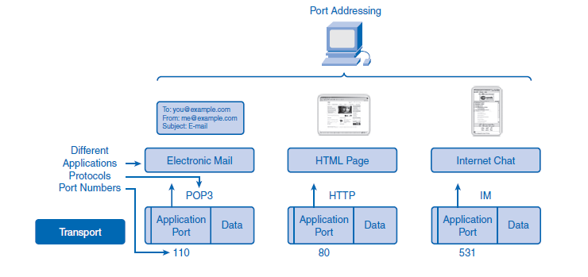
2. Roles of the Transport Layer
Outline
The combination of the transport layer port number and the network layer IP address assigned to the host uniquely identifies a particular process running on a specific host device. This combination is called a socket. A socket pair, consisting of the source and destination IP addresses and port numbers, is also unique and identifies the conversation between the two hosts. For example, an HTTP web page request being sent to a web server (port 80) running on a host with a Layer 3 IPv4 address of 192.168.1.20 would be destined to socket 192.168.1.20:80.
If the web browser requesting the web page is running on host 192.168.100.48 and the dynamic port number assigned to the web browser is 49152, the socket for the web page would be 192.168.100.48:49152. These unique identifiers are the port numbers, and the process of identifying the different conversations through the use of port numbers.

Slide 21
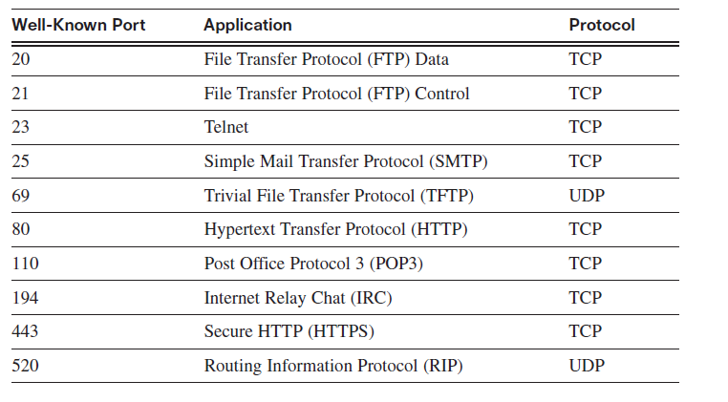
2. Roles of the Transport Layer
Outline
Port Addressing Types and Tools
The Internet Assigned Numbers Authority (IANA) assigns port numbers. IANA is a standards body that is responsible for assigning various addressing standards. The different types of port numbers are
Well-known ports (numbers 0 to 1023)
Registered ports (numbers 1024 to 49151)
Dynamic or private ports (numbers 49152 to 65535)
Well-Known Ports
Well-known ports (numbers 0 to 1023) are reserved for services and applications.

Slide 22
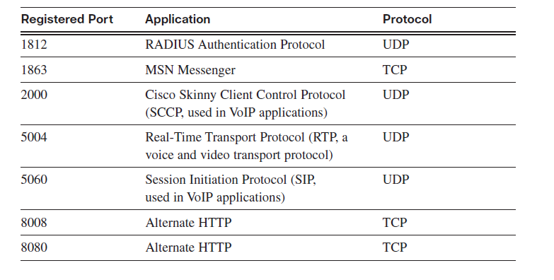
2. Roles of the Transport Layer
Outline
Registered Ports
Registered ports (numbers 1024 to 49151) are assigned to user processes or applications. These processes are primarily individual applications that a user has chosen to install rather than common applications that would receive a well-known port.
Dynamic or Private Ports
Dynamic or private ports (numbers 49152 to 65535), also known as ephemeral ports, are usually assigned dynamically to client applications when initiating a connection. It is not common for a client to connect to a service using dynamic or private ports (although some peer-to-peer file-sharing programs do).

Slide 23
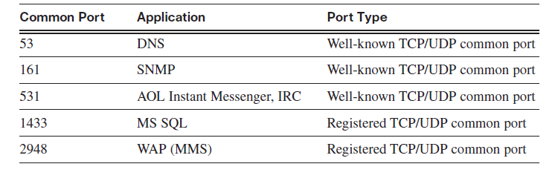
2. Roles of the Transport Layer
Outline
Using Both TCP and UDP
Some applications can use both TCP and UDP. For example, the low overhead of UDP enables DNS to serve many client requests very quickly. Sometimes, however, sending the requested information can require the reliability of TCP. In this case, both protocols use the well-known port number of 53 with this service.

Slide 24
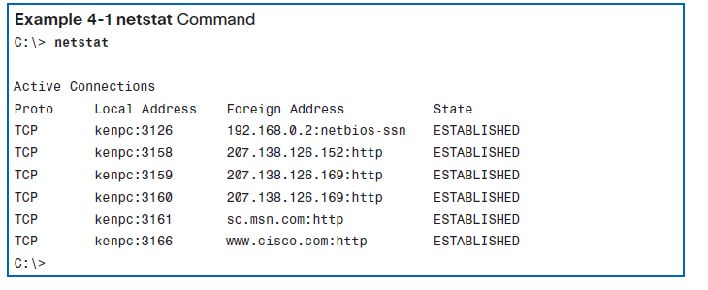
2. Roles of the Transport Layer
Outline
netstat Command
Sometimes it is necessary to know which active TCP connections are open and running on a networked host. The netstat command is an important network utility that you can use to verify those connections. netstat lists the protocol in use, the local address and port number, the destination address and port number, and the state of the connection.

Slide 25
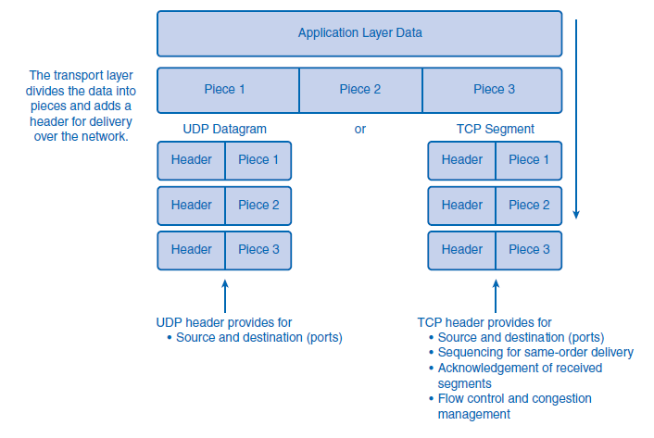
2. Roles of the Transport Layer
Outline
Segmentation and Reassembly: Divide and Conquer
Lecture 2, “Communicating over the Network,” explained how an application passes data down through the various protocols to create a protocol data unit (PDU) that is then transmitted on the medium. At the application layer, the data is passed down and is segmented into pieces. A UDP segment (piece) is called a datagram. A TCP segment (piece) is called a segment. A UDP header provides source and destination (ports). A TCP header provides source and destination (ports), sequencing, acknowledgments, and flow control. At the destination host, this process is reversed until the data can be passed up to the application.

Slide 26
2. Roles of the Transport Layer
Outline
Some applications transmit large amounts of data—in some cases, many gigabytes. Sending all this data in one large piece would be impractical. A large piece of data could take minutes or even hours to send, and no other network traffic could be transmitted at the same time. In addition, if errors occurred during the transmission, the entire data file would be lost or would have to be re-sent. Network devices would not have memory buffers large enough to store this much data while it is being transmitted or received. The size of the segment varies depending on the networking technology and specific physical medium in use. Dividing application data into segments both ensures that data is transmitted within the limits of the media and that data from different applications can be multiplexed onto the media. TCP and UDP handle segmentation differently.

Slide 27
2. Roles of the Transport Layer
Outline
In TCP, each segment header contains a sequence number. This sequence number allows the transport layer functions on the destination host to reassemble segments in the order in which they were transmitted. This ensures that the destination application has the data in the exact form the sender intended.
Although services using UDP also track the conversations between applications, they are not concerned with the order in which the information was transmitted or in maintaining a connection. The UDP header does not include a sequence number. UDP is a simpler design and generates less overhead than TCP, resulting in a faster transfer of data. Information can arrive in a different order than it was transmitted because different packets can take different paths through the network. An application that uses UDP must tolerate the fact that data might not arrive in the order in which it was sent.

Slide 28


THANK YOU

